Slide 1
Escola Básica 2/3 Rainha Santa Isabel Portugal POSTER TIME
Welcoming Diversity at School
Erasmus + Project 2017-2019

Slide 2
Summary :
Different migration routes.
Label/name of the different stages.
Which needs do the migrants have previous to each stage.
Which rights are reached at each stage.
Difficulty to step from one stage to another.
Kind of refugees who reach your country (political, conflict, religious, poverty...)
Origin countries.
Ways of life in the welcoming country, difficulties, advantages...

Slide 3
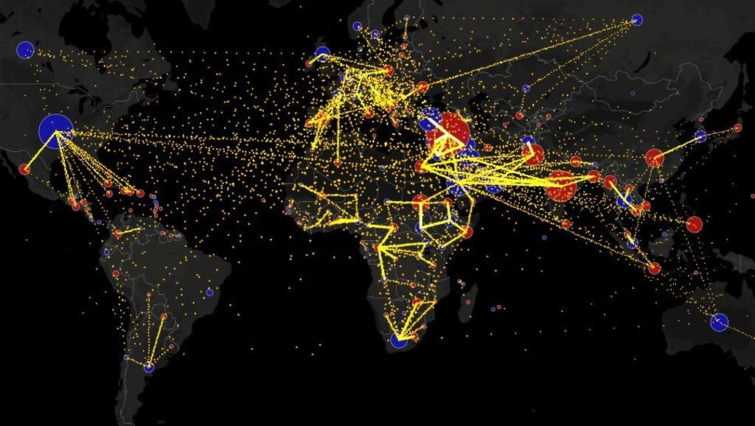
World Migrations
In: https://www.gazetadopovo.com.br/mundo/mapa-mostra-caminhos-da-migracao-no-mundo-todo-confira-e3vg0z3krooiqot30jstbsu2l/

Slide 4
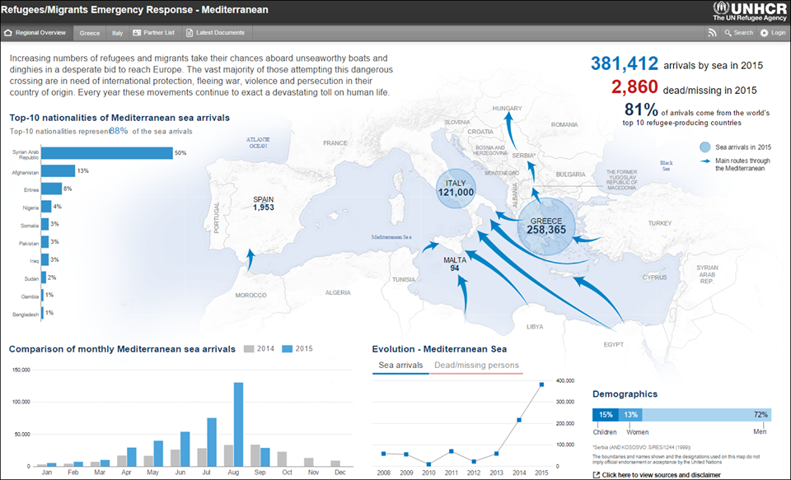
Migrations in the Mediterranean

Slide 5
Four main entery routes for secundary movements in Europe

Slide 6
Step one - identify refugees in need of resettlement
The identification of refugees without resettlement, in an effective and transparent way, guarantees access to the refugees who need them the most, avoiding fraud or arbitrary decisions.

Slide 7
Step Two - Selection
If the identification phase falls to UNHCR, with the collaboration of NGOs and International Organizations, it is our country that have the deciding authority to accept refugees who are candidates for reinstatement and to grant them a permanent right of residence.

Slide 8
Step Three - Preparation for departure
The provision of basic information on travel and life in the country of resettlement prior to departure is essential. Future refurbished should have access to pre-departure cultural orientation programs, which will include practical information on the country, setting realistic goals and adopting / developing the attitudes and skills needed to adapt to the new country. These programs aim to psychologically prepare refugees for the new reality they will face, reducing their anxiety and helping to manage expectations that are sometimes too high.

Slide 9
Step Four - The Trip
This phase concerns the safe and humane transfer of refugees from the country where they are to the country of resettlement. To this end, it will be necessary to organize the required documentation for travelling, travel documents, usually issued by the consular representation of the country of resettlement, exit and transit visas, assistance during the journey, namely at large airports to ensure boarding on connecting flights .

Slide 10
Step Five - Reception Stage
The stage of receiving refugees resettled is the period after arrival at the country of resettlement.

Slide 11
Portuguese data
From the end of 2015 until February 2018, Portugal received 1,674 refugees: 1,192 people from Greece and 340 people from Italy, and accommodated 142 refugees under the Turkish Resettlement Program.

Slide 12
Refugee Support Platform (PAR) - welcomed 671 people out of a total of 1,674 refugees resettled and reinstated in Portugal.
More than 350 Portuguese organizations have decided to cooperate to meet the needs of refugees inside ports, in Europe and in the countries most affected by this global humanitarian crisis.
Until February 2018, Host Institutions, registered with PAR, welcomed 144 families.

Slide 13
Until January 2018, about half of the refugees who arrived in Portugal left the country
https://observador.pt/2018/01/09/cerca-de-metade-dos-refugiados-que-chegaram-a-portugal-abandonaram-o-pais/

Slide 14
Asylum applications in Portugal, 2002-2015 (number of individuals)
Information sources: Serviço de Estrangeiros e Fronteiras (SEF)/Conselho Português para os Refugiados (CPR).

Slide 15
International protection in Portugal (2017

Slide 16
Reception and Integration of Refugees in Portugal
Persons who intend to apply for asylum in Portugal must present themselves to the authorities or to the Foreign Service and Borders - Refugee Division (SEF / DR) within 8 days from the moment of arrival.
Until the decision to admit or refuse the application - which can be delayed - the asylum seekers are issued with a Declaration of Asylum, issued by the SEF.

Slide 17
The Declaration of Request for Asylum:
Is a document proving that the holder has made an application for asylum;
Does not confer right of residence;
It is not an identification document;
Shall be valid for only 20 days after which they are withdrawn.

Slide 18
The Statute Determination Procedure (when the application is filed in national territory)
SEF has 20 days to decide whether to admit the request;
If the decision is negative, the applicant has 5 days to submit a request for reconsideration to the National Commissioner for Refugees, who has 48 hours to decide;
- If, however, the decision of non-admissibility remains, the applicants have 8 days to appeal the decision to the Administrative Circle Court.

Slide 19
Admission of the application
When the application is considered admissible this does not mean that the statute has been granted, but that it is in a position to be analyzed.
When the application is admitted a Provisional Residence Permit is issued that:
♦ It lasts 2 months, renewable for periods of 30 days until the final decision.
Allows:
▪ To work;
▪ Attending vocational training courses;
▪ To study;
▪ Apply for a taxpayer card.
As asylum seekers, people are entitled to free legal assistance and receive emergency social support from the Portuguese Council for Refugees (CPR) in collaboration with other humanitarian cooperation organizations.

Slide 20
Vulnerable cases are:
• Women alone or with minor children;
• Pregnant women;
• Invalid or sick men;
• Children;
• Seniors.
They are supported by the Social Emergency Service of the Santa Casa da Misericórdia de Lisboa

Slide 21
With a Provisional Residence Authorization they receive legal advice from the CPR, but social support will be granted by Social Security until they find paid work and for a maximum period of 4 months (except for very particular situations).

Slide 22
After the instruction, the request can be:
Deferred - the applicant receives the title of Refugee or, alternatively, Residence Permit for humanitarian reasons.
Residence Permit proves the legal residence of a foreigner in Portugal. It is renewable annually for a period of 5 years.
Dismissed - a situation in which the CPR's Legal Office must be consulted, so that it can assist it in the request for legal aid and appeal within 20 days to the Supreme Administrative Court.

Slide 23
ACCOMMODATION AND HOUSING
Portuguese Council for Refugees has a Reception Center where applicants can stay for a month while awaiting the decision on the admissibility of the request;
Social Emergency Division of the Santa Casa da Misericórdia de Lisboa support for vulnerable cases;
Transitory accommodation as people await the decision of the authorities on the application for asylum: Salvation Army Reception Center (Shelter Center for the Homeless);
In addition to these options, applicants may also rent rooms or parts of the home.

Slide 24
Refugee Shelter Center in Loures (CAR)

Slide 25
WELCOME HOUSE FOR REFUGEE CHILDREN (C.A.C.R.)

Slide 26
Space "The Child“, in Bobadela (Loures)

Slide 27
HEALTH ASSISTANCE
Regardless of whether they are holders of Residence Permit (provisional or not), asylum seekers, stateless persons and refugees are entitled to medical and medical assistance on equal terms with the Portuguese population.
This means that they have the right:
- to enroll in the Health Centers in the residence area;
- to use the Permanent Attendance Services;
- to resort to hospital emergencies.

Slide 28
EMPLOYMENT AND VOCATIONAL TRAINING
Before an Interim Residence Authorization is granted, it is not possible for an asylum seeker to have access to or pursue any professional activity, as well as receive professional training.
It´s only after the granting of the Residence Permit that a foreigner is considered fully qualified to reside in Portugal, at which time they can pursue a profession.
But the conditions of refugee access to work are not the same as for national citizens.

Slide 29
EDUCATION
With regard to access to education, the following should be distinguished:
situations of school-age individuals;
situations of adults who:
- wish to fulfill compulsory schooling;
- wish to pursue studies or pursue a professional activity;
- they wish to see the training carried out in the country of origin recognized.

Slide 30
EDUCATION
Applicants for school-age asylum and temporary residence permit may attend compulsory schooling under the same conditions as nationals.
If they have documentation of their education in their country of origin, they should request equivalence of their studies in order to be integrated into the Education System.
If they do not have the required documentation, they should ask for a diagnostic test to be inserted in the Portuguese Teaching System.
It is very important, the learning of the Portuguese Language. Without the knowledge of the language it is not possible to study and it becomes more difficult to find work.
The CPR has free Portuguese language courses. These courses also exist in some Universities, Institutes and Language Centers.

