Slide 1
How Spain is?
Spain

Slide 2
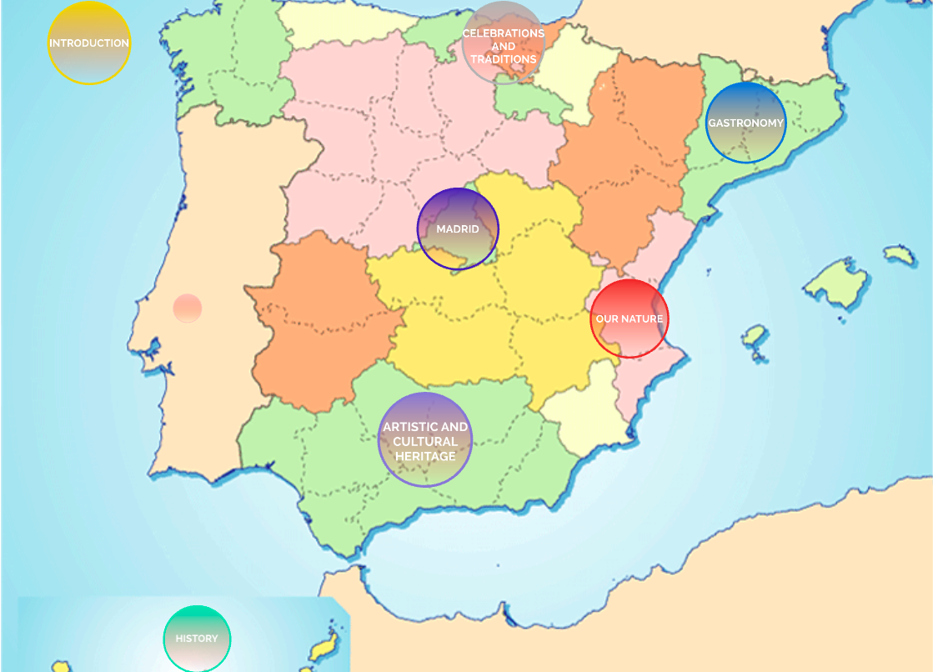

Slide 3
Spain
Now, to start, we are going to show you a video. With that video, you will know our country through the 5 senses.

Slide 6
Spain’s history
In our history we had some influences and facts that have marked it.

Slide 8
Romans (218 b.c – early fifth century)
Hispania was the name which the Romans called the set of territories that were conquered by them.
This period was extensive about 7 centuries.
After the period of conquest, Hispania became a fundamental part of the Roman Empire, providing it with an enormous wealth of material and human resources, and for centuries being one of the most stable parts of the Roman world and cradle of some rulers of the empire.
Now we keep important architectural constructions of them

Slide 10
Arabians (711-1492)
The conquest of the Visigothic kingdom by muslim leaders of the Omeya Caliphate was a long process, which lasted fifteen years, from 711 to 726, in which the Iberian Peninsula was taken.
Al-Ándalus was the name with which they called the conquered territory.
Until in 1492 the Catholic Monarchs recovered the last part of the territory of Al-Andalus; Granada.

Slide 12
Hispanic Monarchy
The conquest of the Visigothic kingdom by muslim leaders of the Omeya Caliphate was a long process, which lasted fifteen years, from 711 to 726, in which the Iberian Peninsula was taken.
Al-Ándalus was the name with which they called the conquered territory.
Until in 1492 the Catholic Monarchs recovered the last part of the territory of Al-Andalus; Granada.

Slide 14
Artistic and cultural heritage
Spain’s unique heritage features myriad treasures of incalculable artistic, historical, and cultural value. Our rich heritage is endorsed by UNESCO: its World Heritage list includes more than 45 cultural and natural gems in Spain, (including the cave paintings of Altamira and the Camino de Santiago¨The Way of Saint James¨. Our country also has more than 15 elements on its Intangible Cultural Heritage list( such as flamenco or the Valencia Fallas festivities). Apart from natural sites, castles, palaces, cathedrals, and festivals and other traditions, Spain has wonderful, world-famous museums (Prado, Reina Sofía, Guggenheim Bilbao, etc.) and such stunning examples of the architectural avant-garde as the Guggenheim Bilbao and Barcelona’s Agbar Tower, ​​among many others.

Slide 16
Our nature
Forests, deserts, steep mountains, vast plains, dormant volcanoes, rough seas, beaches with calm waters... Spain offers landscapes full of contrasts, where you can find beauty everywhere. In our country, visitors have many options: taking the funicular railway to the top of the Teide, climbing in the heart of the Picos de Europa mountains, walking the Caminito del Rey, enjoying the colourful Irati forest or the greenery of Ordesa or Garrotxa, being fascinated by the Biosphere Reserves of Doñana or Urdaibai, swimming in the turquoise waters of Menorca, or relaxing on the Canary Islands’ beaches.

Slide 18
Gatronomy in Spain
Spain has 195 restaurants with stars in the prestigious Michelin Guide, and 11 of them have three stars, its highest accolade—all numbers indicating ​​the international recognition of Spanish food. In addition to our high-end cuisine, pintxos and tapas are world famous, and our traditional recipes are also highly appreciated. The secret of Spanish cuisine is our wide variety of high-quality products including olive oil, cheese, wine, Iberian pork, fish and seafood.

Slide 20
Our celebrations and traditions
In every Spanish town, there is a festivity to celebrate. Some of the best-known events are the festival of San Fermín in Pamplona, the Fallas in Valencia, the Tomatina in Buñol, and the April Fair in Seville. There are also religious events, such as Holy Week in Andalusia (especially in Seville and Malaga) and Castile and Leon (Valladolid and Zamora), the Mystery Play of Elche, and the Chant of the Sybil in Majorca—these last two both on UNESCO’s Intangible Cultural Heritage list.

